Slide 1
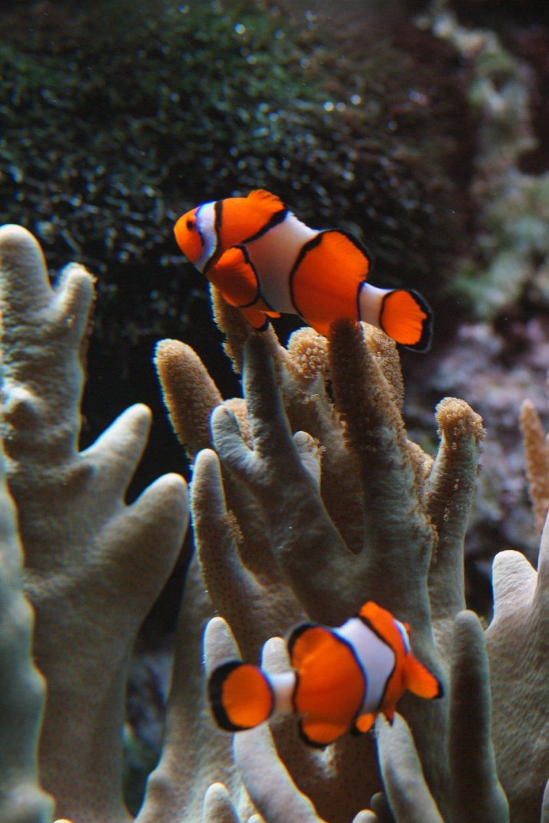
What are the parts of an ecosystem?
Chapter 5, Lesson 1

Slide 2
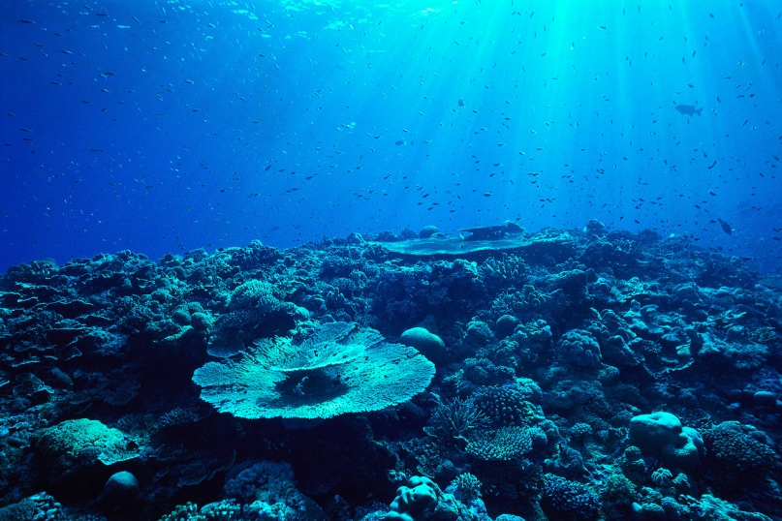
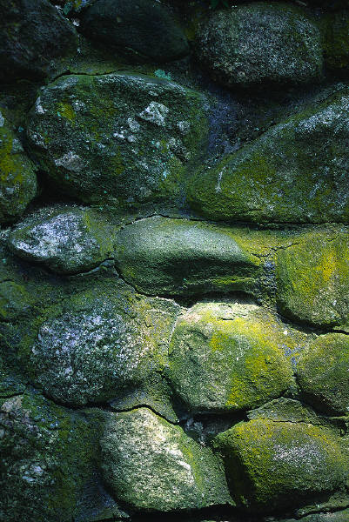
Environment-All the living and nonliving things that affect an organism
Ecosystem-Living and nonliving things in an area that combines with it’s environment.
An ecosystem can be as small as the space under a rock.
An ecosystem can also be as large as a forest

Slide 3
Forest Ecosystem Can you name some parts?
Non-living Things | Living Things
Water | Trees
Air | Animals
Soil | Birds
Climate | Plants
?? | ???

Slide 4
Parts of an Ecosystem
Climate-The climate is the average weather over many years. (Includes temperature and rainfall)
Individual-one plant or animal in the ecosystem (one duck, one honeybee, one blueberry bush)
Population-A group made up of the same kind of individuals (ducks, honeybees, group of blueberry bushes)
Community-All the populations that live in the same place. All the birds, all the plants, etc.

Slide 5
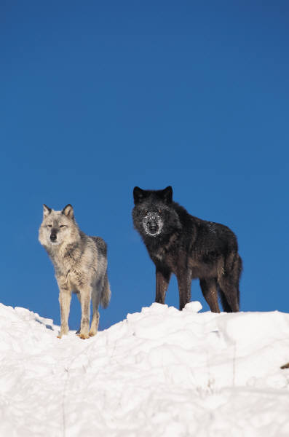
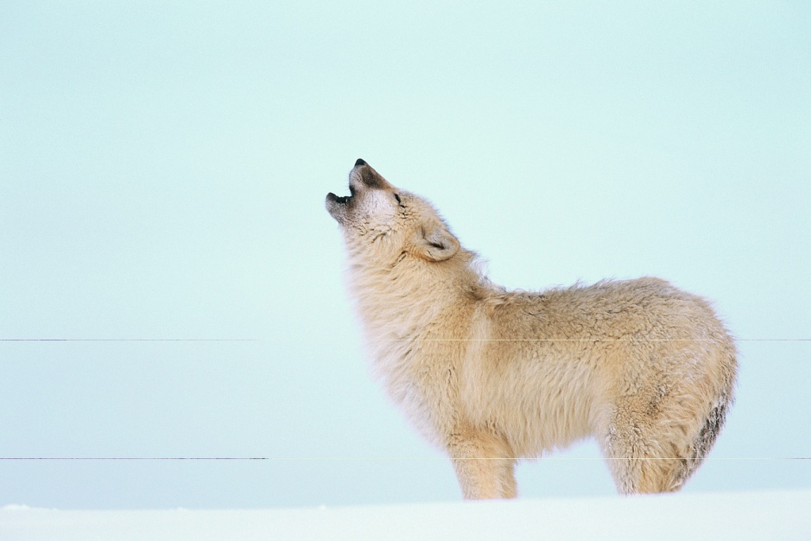
Many animals live in groups. A wolf population may have several packs. In Yellowstone National Park, there are 19 packs.

Slide 6
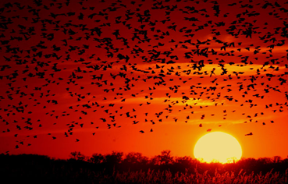
Some populations can live in more than one kind of ecosystem.
The red-winged blackbird lives in wetlands but if one ecosystem no longer meets their needs, they fly to another one.
Can you name another animal that can live in a different ecosystem?

Slide 7
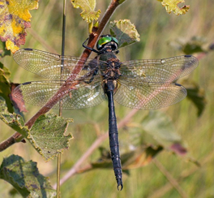
Some animals can only live in one ecosystem.
The Hine’s emerald dragonfly can only live in certain wetlands. It will not survive in another ecosystem.
It’s total population is small because of this.

Slide 8
A community is made up of all the populations that live in the same place.
Look on page 206 to discover a community and the Taiga Ecosystem.
Let’s read more about a community on that page.

